Slide 1


First Seminar
Syrian Arab Republic
Syrian Private University
Faculty of Artificial Intelligence Engineering
Design and implementation of an ai-based fruit-picking robotic system
Presented by:
Dalal Mohammad Samih AlKadi
Riman Firas AlZoubi
Supervised by:
Dr. Bashar Mohammad
Eng. Marwa AlSafadi

Slide 2
Agenda
Project Overview
Scope and Phases
Completed Work
Next Steps
Specs
Introduction

Slide 3
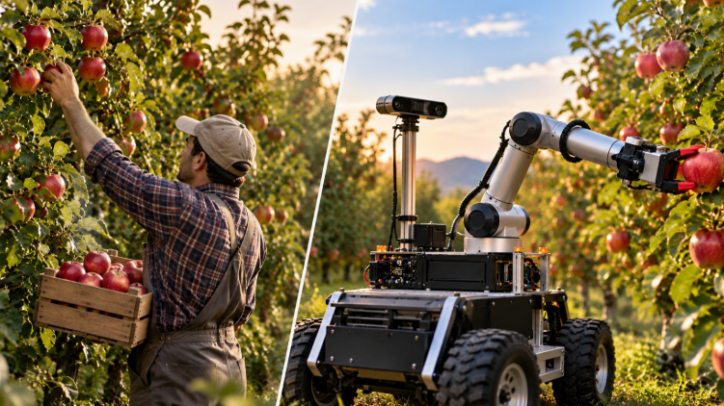
Introduction:
The agricultural sector is witnessing rapid development in the integration of artificial intelligence and robotics, aimed at automating farming operations and enhancing their efficiency. Harvesting—the process of picking fruit—requires particular precision and care to maintain the quality of the produce. In this context, there is a growing need for the development of intelligent robotic systems that utilize computer vision to detect and locate fruit. Such systems pave the way for automated harvesting, helping to reduce the need for manual labor and improve overall harvest efficiency.

Slide 4
Challenges and Problems:
Project Motivation:
Variable Lighting
Fruit Occlusion
Overlapping Objects
Fruit Integrity
Approach Accuracy
Improve Harvest Efficiency
Reduce Costs
Support Smart Farming
Address Labor Shortages
Preserve Fruit Quality

Slide 5

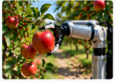
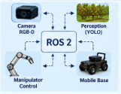
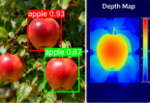
Studying research papers :
An Automated Apple Harvesting Robot
Designing an integrated robot for apple picking.
Integrating a camera, a robotic arm, and a gripper.
Testing the system in a real-world orchard environment.
Automatic Fruit Picking Technology
. A comprehensive review of robotic fruit-harvesting technologies.
Focus on detection, localization, and safe harvesting.
A comparison of various types of robotic grippers and arms.
2
1
Robotic Harvesting of Apples Using ROS2
Integrating vision and control units.
Implementing and testing an actual harvesting robot.
Exchanging data between the camera, the robotic arm, and the mobile platform.
Dual-Detector Vision and Depth_Aware Back-Prejection
Detecting apples using deep learning models.
Integrating visual detection with depth data.
Estimating 3D location.
3
4

Slide 6
COMPARISON OF PREVIOUS RESEARCH PAPERS
Relevance to our Project | Main Contribution | Technical Approach | Research Paper
Identifying suitable system requirements and design alternatives | Comparison of selective harvesting technologies and their challenges | Review of vision systems, robotic arms, grippers, and harvesting methods | Automatic Fruit Picking Technology
Understanding fruit localization, handling, and practical harvesting challenges | Design and field evaluation of an integrated harvesting robot | O2RNet, RGB-D sensing, laser-based localization, 4-DOF arm, suction gripper | An Automated Apple Harvesting Robot
Supporting our proposed detection and 3D position estimation pipeline | Apple detection and 3D localization | YOLOv8, Mask R-CNN, RGB-D depth processing | Dual-Detector Vision and Depth_Aware Back-Prejection
Guiding software communication and future system integration | Integration of perception and robotic harvesting components | ROS 2, YOLOv5, stereo/RGB-D cameras, robotic arm | Robotic Harvesting of Apples Using ROS2

Slide 7
Project Overview:
Project Objective
The project aims to design and develop an intelligent robotic system for harvesting apples, utilizing artificial intelligence and computer vision technologies. This enables the precise detection and localization of the fruit, facilitating automated harvesting, reducing human effort, and preserving the quality of the produce.
The project concept involves developing a mobile robot equipped with a robotic arm, a gripper, and a camera. Deep learning algorithms, such as YOLO, are used to detect apples, while depth data is leveraged to determine their 3D coordinates. The current phase focuses on simulating the system using ROS 2 and Gazebo to test vision algorithms and the integration of system components before proceeding to practical implementation.
Steps
Reviewing previous research on agricultural robotics and fruit-detection algorithms.
Project Description
Defining technical requirements and establishing the specifications for the robotic system.
Creating an agricultural simulation environment using Gazebo—incorporating the robot and apple trees—setting up the ROS2 framework, and integrating the robot’s components.
Developing a fruit-detection algorithm using YOLO.
Testing system performance, evaluating detection accuracy, localization precision, and processing speed.
Refining the model and transitioning to practical, real-world implementation in subsequent stages.

Slide 8
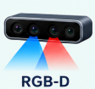


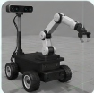
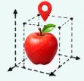
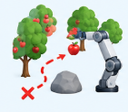
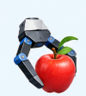
Scope of work and its phases:
Future Development:
Real-World Application
Current phase: Simulation
Platform fabrication and motor selection
A virtual orchard environment in Gazebo
Installation of the arm, gripper, and cameras
Virtual robot and arm model
Arm motion planning and obstacle avoidance
camera and ROS 2
Discovering the apples and estimating their location
Actual harvesting and minimizing fruit damage
Field tests and performance optimization
Quantitative tests and documentation of results

Slide 9
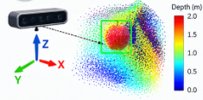
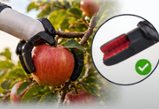

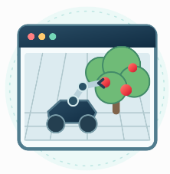
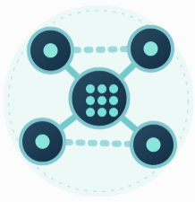
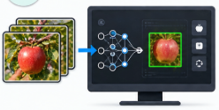
General project description:
camera
The Arm and the Gripper
Mobile robot
GAZEBO
ROS2
Data processing

Slide 10
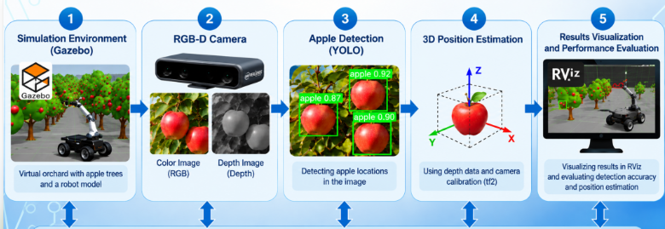
Functional structure of the proposed system:
ROS2
Connecting system components and exchanging information

Slide 11

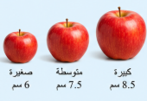
Fruit specifications
Terms and Conditions:
Type:
Red apples
Shape:
Nearly spherical
Fruit condition:
Ripe and attached to the tree
Harvesting condition:
Avoid damaging the fruits and branches.

Slide 12
Terms and Conditions:
Work environment specifications
Working Environment
A virtual apple orchard in Gazebo
Terrain Characteristics
Agricultural land that may contain obstacles and variations in elevation
Fruit height
Determined in accordance with the reach of the robotic arm
Viewing conditions:
Variable lighting, with shadows and partial obscuring of the fruits.
Distribution of fruits
Fruits are solitary and closely spaced, with the possibility of being obscured by leaves and branches.

Slide 13
Mechanical Requirements
Terms and Conditions:
Mobile Platform:
Determining appropriate dimensions for the miniature robot, ensuring stability and ease of movement within an agricultural environment, and utilizing a four-wheeled platform..
Locomotion System:
Studying various types of rubber wheels and tracks, and evaluating the options based on the nature of the agricultural terrain
Robotic Arm
Determining the appropriate number of degrees of freedom, defining the reach to allow for fruit picking, and accounting for the required load capacity based on the weight of the fruit.
Gripper:
Studying potential types of grippers, ensuring the safety of the fruit to prevent damage, and facilitating ease of control and integration with the robotic arm.

Slide 14
Vision & Control
Terms and Conditions:
Simulation of the Robot and Agricultural Environment
Creating a Virtual Apple Orchard
Testing Detection and Localization Algorithms Prior to Practical Implementation
Detecting apples in an image
Determining their 2D locations (detection bounding boxes)
Using a pre-trained model or creating a suitable dataset
Acquiring color images and depth data
Locating fruits and determining the distance to them
Integrating data into ROS2
Connecting various software modules
Real-time data exchange
Using ready-made packages for integration and connectivity

Slide 15
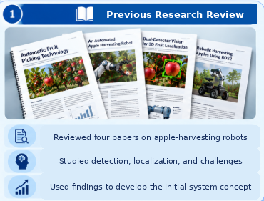
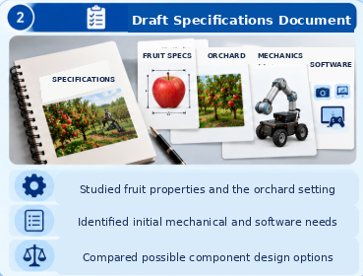
Work completed to date :

Slide 16
Setting up the work environment
Tests and Assessment
3D Localization
Build Simulation
Develop Vision System
Future Action Plan:

Slide 17
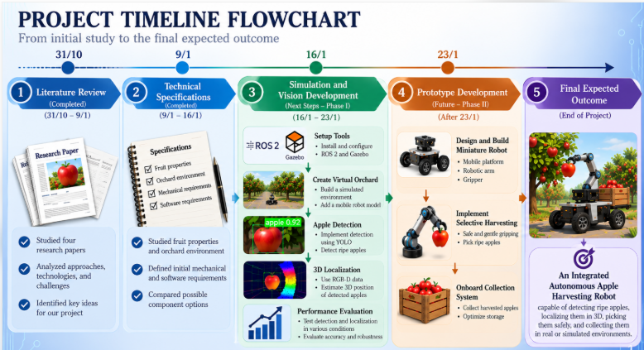

Slide 18
Thank
for
listening

